Slide 1
Real-Time Deep Visual Semantic Alignments For Automatic Image Captions
Project By:
Hamna Akram
Supervisor:
Sir Ammar Ajmal
1

Slide 2
Goal and Deliverables
Goal
Describe the contents of an image in natural language by understanding the spatial relationship between objects
Create image feature encodings based on detected objects
Understand linguistic features
Create word embeddings for sentences
Generate Image captions
Implement system on raspberry Pi
Deliverables
2

Slide 3
Methodology
Dataset
Image Depiction
Novel Caption
Images
Text and Visual Alignment
Image Depiction
Extracting features from the image to identify object
Sentences
Sentence Depiction
Sentence Depiction
Encode linguistic features of the dataset
Text Segment Alignment
Bias the system to generate novel captions based on image and sentence depiction
3
Research Paper: Explain Images with Multimodal Recurrent Neural Networks, Mao et al.

Slide 4
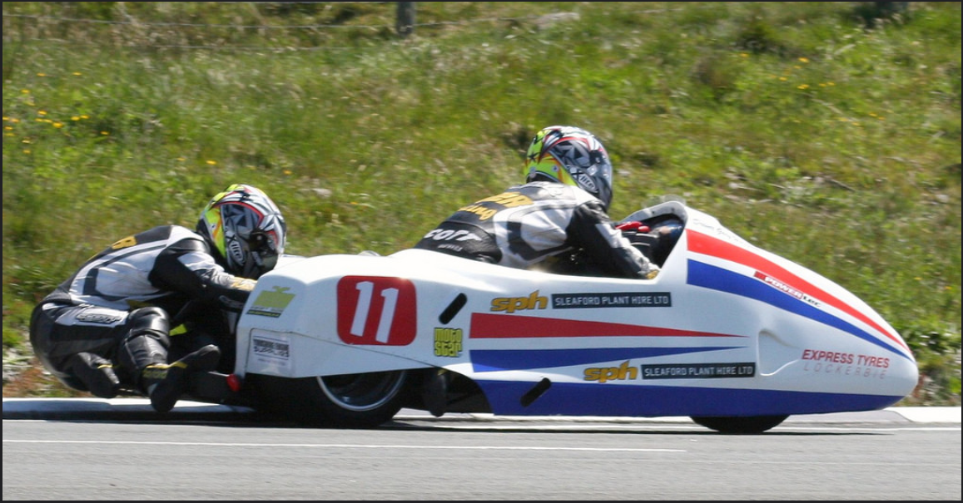
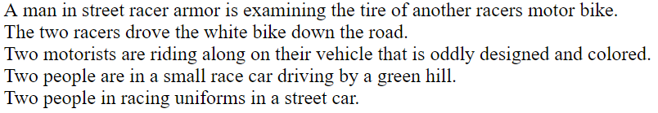
Dataset
Flickr8k Dataset
8,000 images paired with five different captions providing clear descriptions of the salient entities
6000 images for training
1000 images for testing
1000 images for validation
Dataset: https://illinois.edu/fb/sec/1713398
Research paper: Framing Image Description as a Ranking Task, Hodosh et al.
4

Slide 5
Visual Segmentation
Understanding and extracting image features using convolutional neural networks
Input Image: 224*224
Total Layers: 16
Output: vector size 1x4096
Layers
Convolution
Relu
Pooling
Flattening
Full Connection
5
Research Paper: VERY DEEP CONVOLUTIONAL NETWORKS, Zisserman et al.

Slide 6
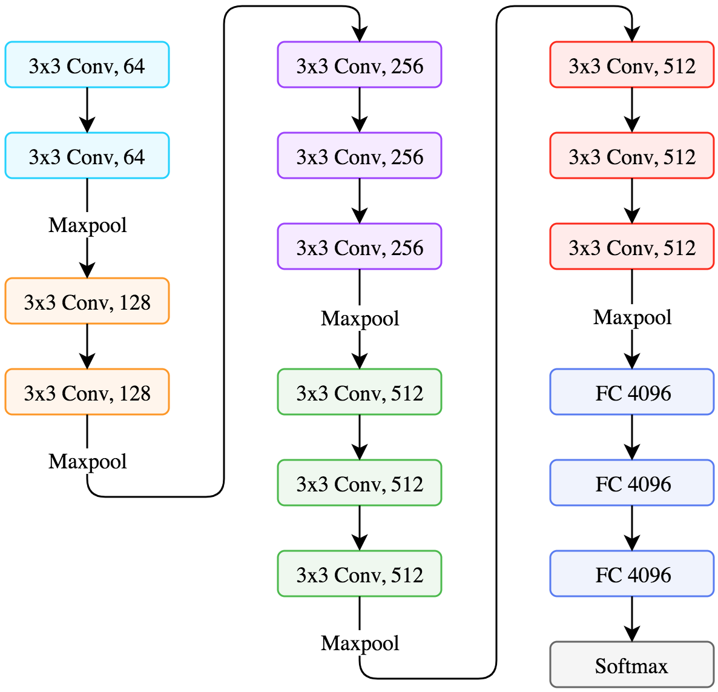
Convolutional Layers: 16
Fully Connected Layers: 3
Stride: 1
Activation Function: ReLu
Max-Pooling: 2x2 window
Padding: s/t spatial resolution is preserved.
Convolutional filters: Starting from 64, double after each max-pooling layer until 512
Filter sizes: 3x3, 1x1
Total Calculated parameters = 138,357,544
Parameters Instantiation of CNN
6

Slide 7
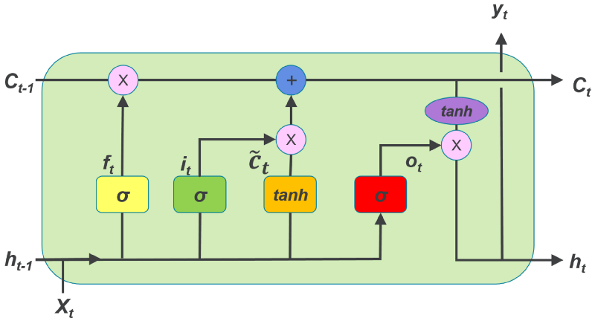
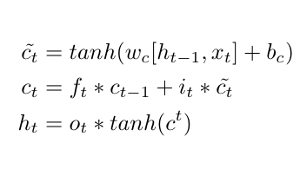
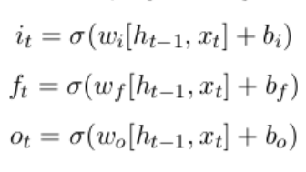
Sentence Depiction
To produce a single vector representing a sequence
256 memory units
Output: Element Vector of size 256
Three Neural Network Layers
Input Gate
Forget Gate
Output Gate
7
Research Paper: What is the Role of Recurrent Neural Networks (RNNs) in an Image, Tanti et al.

Slide 8
Consider Sentence: ‘Little girl is running in field’
Input sequence | Target Word
startseq | Little
startseq, little | girl
startseq, little, girl | running
startseq, little, girl, running | in
startseq, little, girl, running, in | field
startseq, little, girl, running, in, field | endseq
startseq, little, girl, running, in, field, endseq
Example
Girl
Running
in
Field
Output Layer
Hidden Layer
Little
Little Girl
Little girl Running
Little girl Running
in
Input Layer
8

Slide 9
Text Segment Alignment
Bias the system to generate novel captions based on image and sentence depiction
Feed Forward Neural Network
Activation Function: Softmax
Layers = 256
Image Embedding
Compare feature probability
Complete Sentence
Sentence Embeddings
9
Research Paper: Where to put the Image in an Image Caption, Tanti et al.

Slide 10
System Implementation
1

Slide 11
Progressive Loading
Used to fit the models on CPU
Incorporates prior knowledge at each layer of the feature hierarchy
Total Epochs= 20
Trained 20 models from which best model was selected based on Bleu scores, Cider scores and Meteor Scores
Initial learning rate = 0.001 with 3 pictures per batch
11

Slide 12
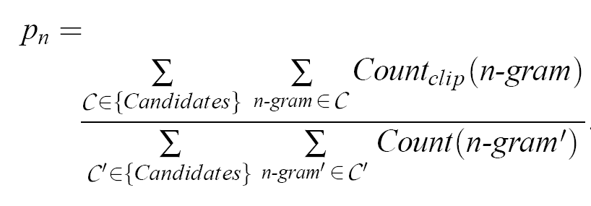
BLEU Score
Calculate the count of word ‘the’
Compute count-clip
Compute Bleu-score
Input 1: The cat is on the mat
Input 2: There is a cat on the mat
Output: The The The cat is
Count | Count clip
3 | 2
Pn = 2/3 = 0.66
12

Slide 13
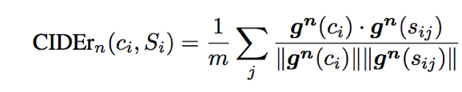
CIDEr Score
Based on co-sine similarity
Captures Accuracy
Takes mean across reference sentences for consensus
n-gram
j-th reference
candidate sentence
set of reference sentences
average over references
cosine similarity
13

Slide 14
METEOR Score
Compute Harmonic Mean
Compute Harmonic Mean
Calculate Penalty
Calculate Penalty
Find Score
Find Score
Calculate precision
Calculate precision
Reference : The cat sat on the mat
Result: on the mat sat the cat
Recall = 6/6 ; Precision = 6/6
Fmean = 10x1x1/1+9x1 = 1
p = 0.5 x (6/6)^3
M = 1(1-0.5) = 0.5
Compute recall
Compute recall
14
Reference: METEOR: An Automatic Metric for MT Evaluation, Banerjee et al.

Slide 15
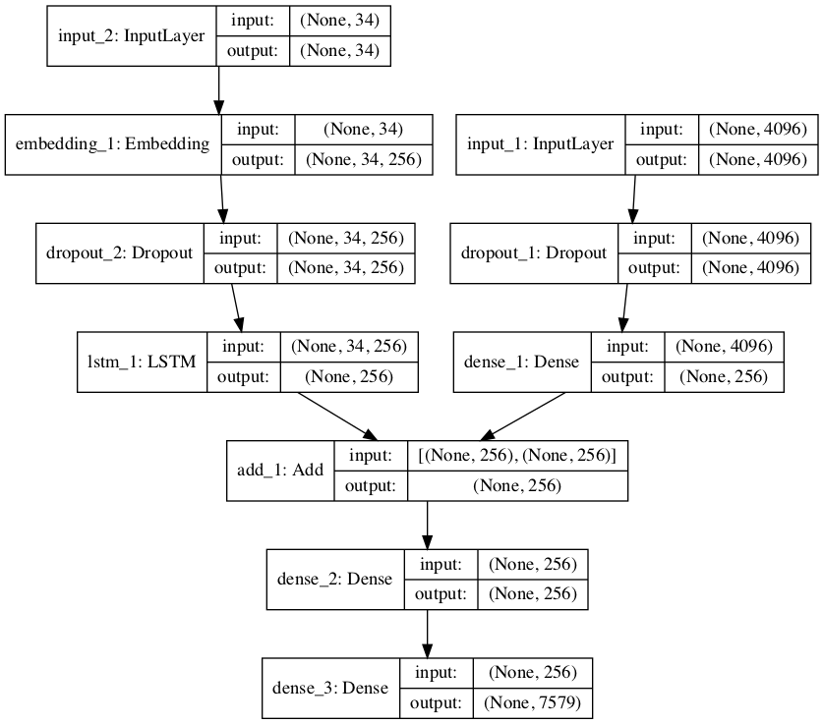
Visual Structure of the implemented network
CNN
LSTM
FF Neural Network
15

Slide 16
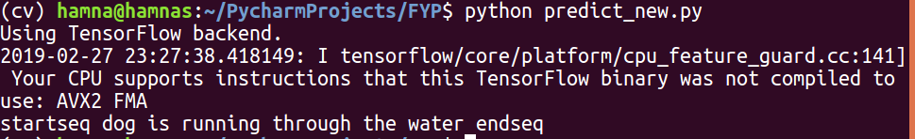
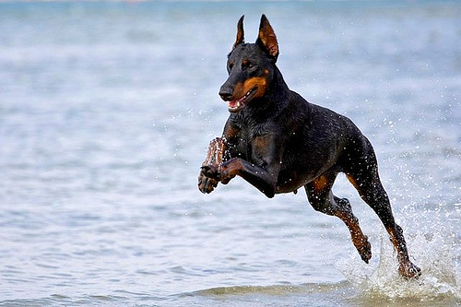
Evaluation Scores and Results
BLEU Score | CIDEr Score | METEOR Score
BLEU-1: 0.540172 BLEU-2: 0.297149 BLEU-3: 0.205777 BLEU-4: 0.094816 | 0.4943 | 0.219347
1

Slide 17
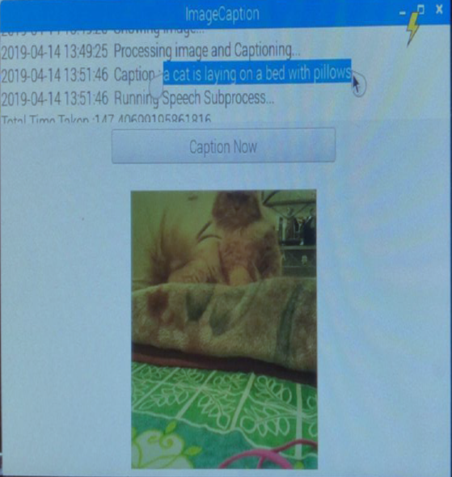
Results on Raspberry-Pi
<number>

Slide 18
Thanks!
Any questions?
<number>

